Slide 1
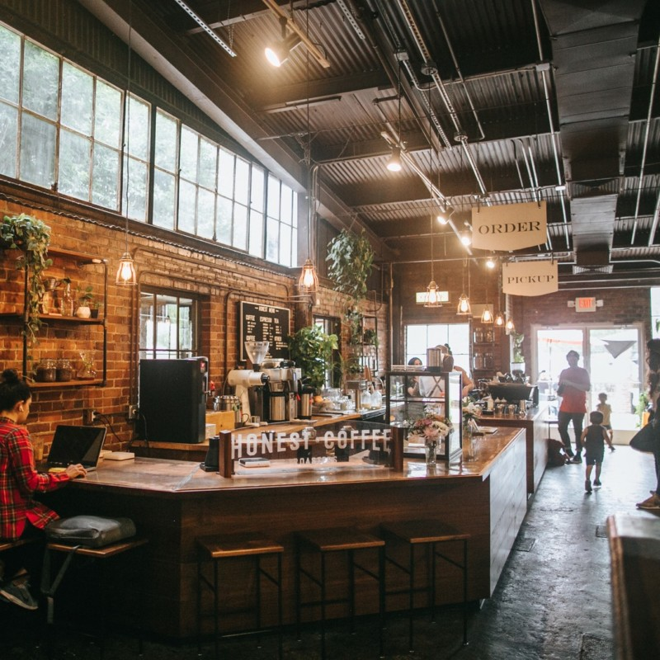
COFFEE SHOP
ANALYSIS
Presented by: Qihan Liu, Kaiting Liang,Yina Luo, Jingyi Guo
Date:04/24/23

Slide 2
TABLE OF CONTENTS
01
02
03
04
05
06
02
01
INTRODUCTION & DATA OVERVIEW
EXPLORATORY DATA ANALYSIS
03
04
MODELING &
FEATURE IMPORTANCE
KEY FINDINGS & INSIGHTS

Slide 3

06
Introduction &
Data Overview
01

Slide 4
Motivation
Improve customer satisfaction
Provide a better experience for customers(reducing waiting times)
Customer Segmentation
Target customers precisely for rewards program (increase customers’ loyalty)
Increase revenue
Meeting customer needs(personalized offers and promotions)

Slide 5
Business Goals
Increase revenue
Improve customer experience
Target customers for the rewards program

Slide 6
Data Description
Data Overview: 13 variables and 1.8 million columns
transaction_id: unique identifier for each transaction
age: age of the customer making the transaction
income: income of the customer making the transaction
sex: sex of the customer making the transaction
rewards_member: whether or not the customer is a rewards program member
occupation: the occupation of the customer making the transaction
num_items: number of items purchased in the transaction
purchase_method: method of purchase (e.g., cash, credit card)
wait_time: time spent waiting in line before making the transaction in minutes
purchase_amount: total purchase amount of the transaction in USD
store_location: location of the store where the transaction took place
transaction_time: hour when the transaction took place
day_of_week: day of the week when the transaction took place

Slide 7

06
Exploratory Data Analysis
02

Slide 8
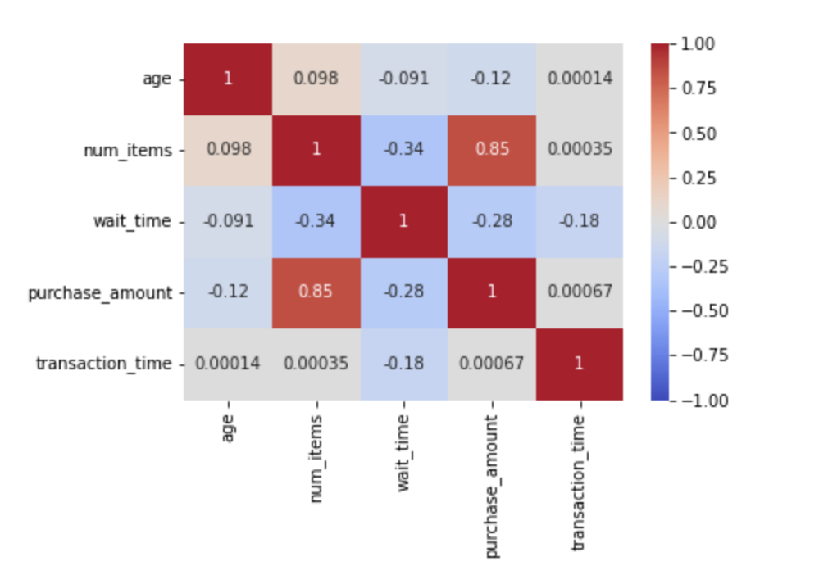
num_items and purchase_amount
HIGHLY CORRELATED
Correlation Matrix

Slide 9
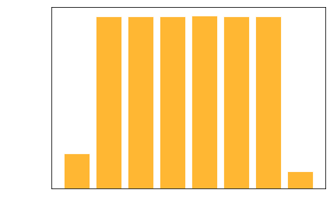
Age Distribution - Normal Distribution
Customer Demographic

Slide 10
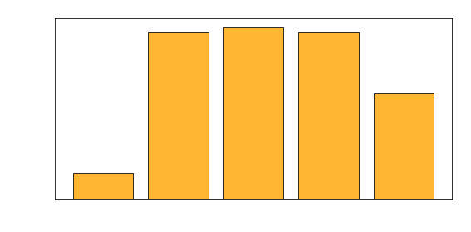
Income Distribution -
Slightly Left Skewed
Customer Demographic

Slide 11
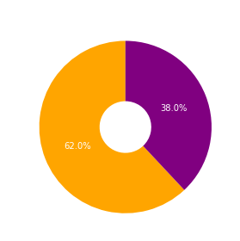
Customer Demographic
60% of Customers are Female

Slide 12
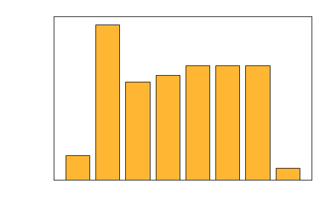
Spending Analysis
Customers in 20s Spend the Most

Slide 13
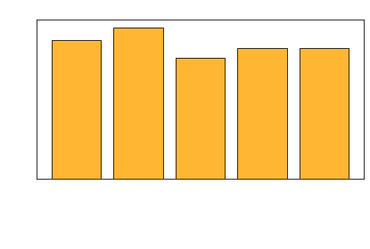
Average Spending
by Salary Range
Spending Analysis

Slide 14
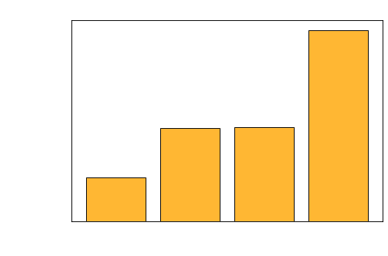
Employed people Spend the Most
Spending Analysis

Slide 15
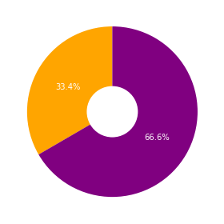
⅓ of customer is in rewards membership
Membership vs. Non-Membership

Slide 16
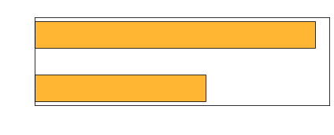
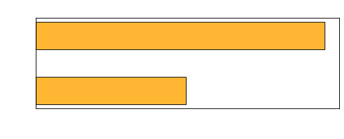
Avg Spending/
Avg Number of Items
Membership vs. Non-Membership

Slide 17
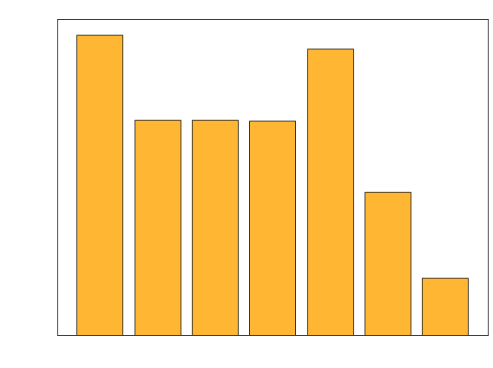
Number of Transactions made
based on Weekdays
Weekdays Analysis

Slide 18
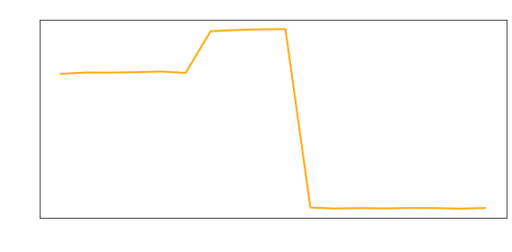
Average Waiting Time
based on Hours
Hourly Waiting Time Analysis

Slide 19
Feature Engineering
Categorize day of week: Weekdays and Weekends
Encode Category Variables: Sex, Rewards_member, Occupation, Puchase_method, Store_location, Day_of_week
Either select num_items or purchase_amount in modeling

Slide 20

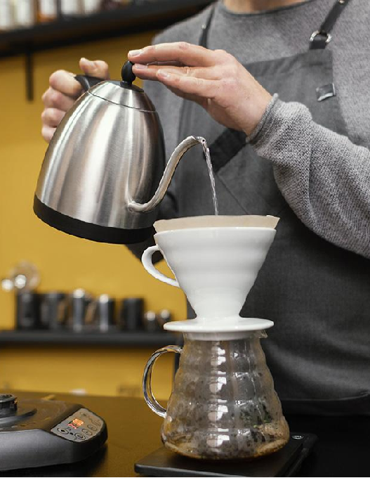
03
Modeling
03
Model Selection &
Feature Importance

Slide 21
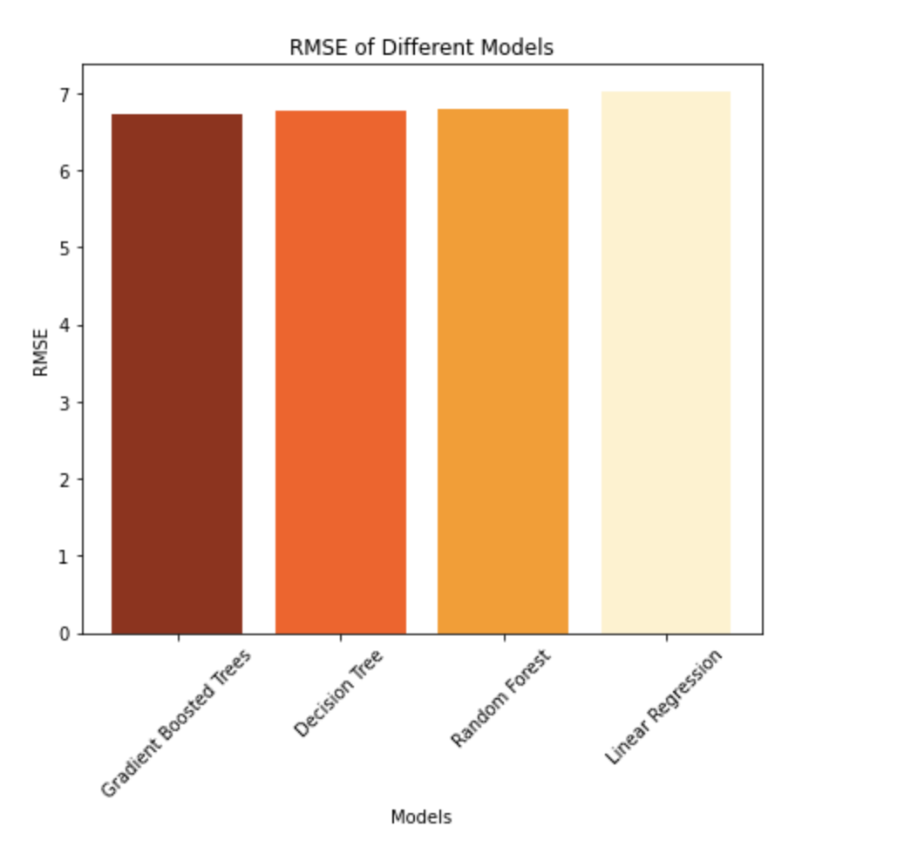
Model Selection
Target Variable: Purchase_Amount
Linear Regression
regParam: 0.0 elasticNetParam: 0.0
Decision Tree
maxDepth: 2 minInstances Per Node: 10
Random Forest
maxDepth: 2 numTrees: 100
Gradient Boosting
Linear Regression RMSE: 7.022
Decision Tree RMSE: 6.760
Random Forest RMSE: 6.791
Gradient Boosted Trees RMSE: 6.725
maxDepth:2 maxIter:50

Slide 22
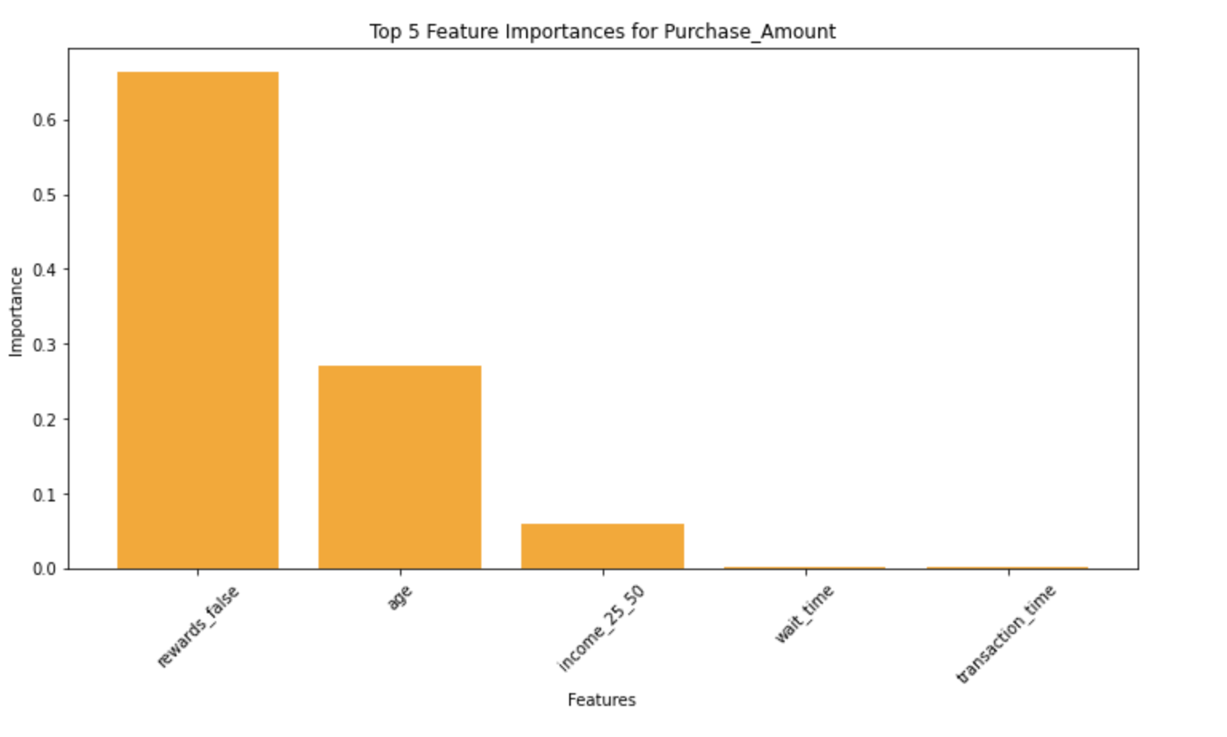
Feature Importance
rewards_fales | 0.66327
age | 0.27117
income_25_50 | 0.05886
wait_time | 0.00238
transaction_time | 0.00172

Slide 23
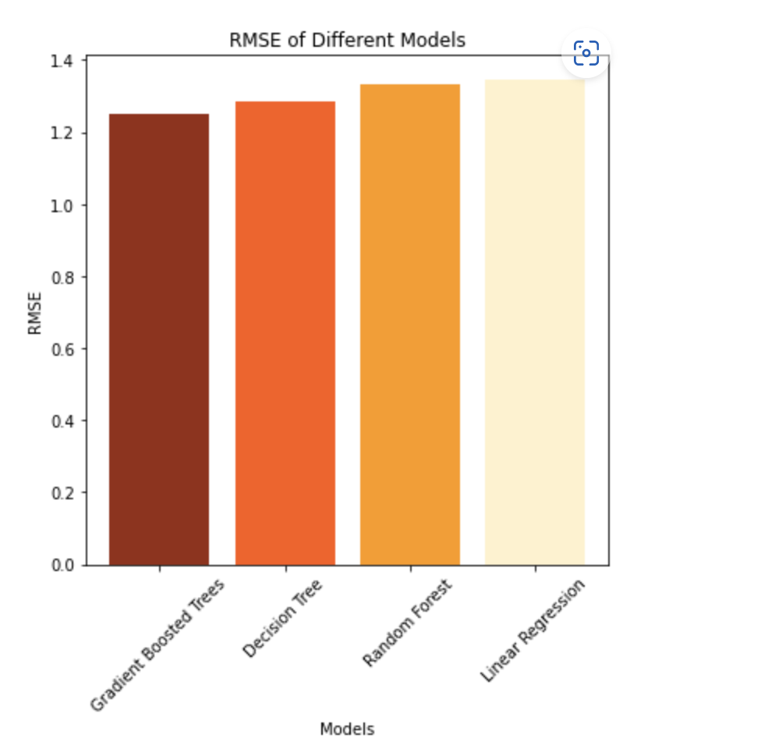
Model Selection
Target Variable:
Wait_Time
Linear Regression
regParam: 0.1 elasticNetParam: 0
Decision Tree
maxDepth: 5 minInstancesPerNode: 10
Random Forest
maxDepth: 2 numTrees: 50
Gradient Boosting
Linear Regression RMSE: 1.346
Decision Tree RMSE: 1.282
Random Forest RMSE: 1.331
Gradient Boosted Trees RMSE: 1.249
maxDepth:2 maxIter:10

Slide 24
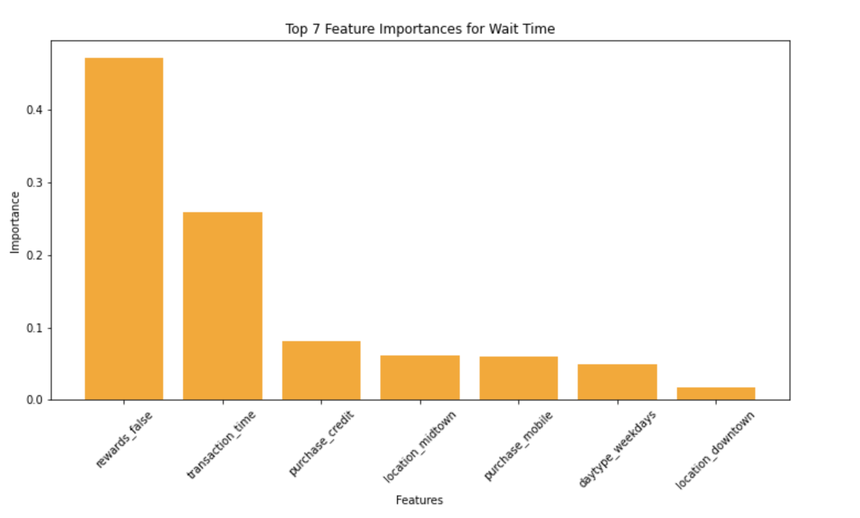
Feature Importance
rewards_fales | 0.47266
transaction_time | 0.25881
purchase_credit | 0.08153
location_midtown | 0.06182
purchase_mobile | 0.05912
daytype_weekdays | 0.04885
location_downtown | 0.01689

Slide 25

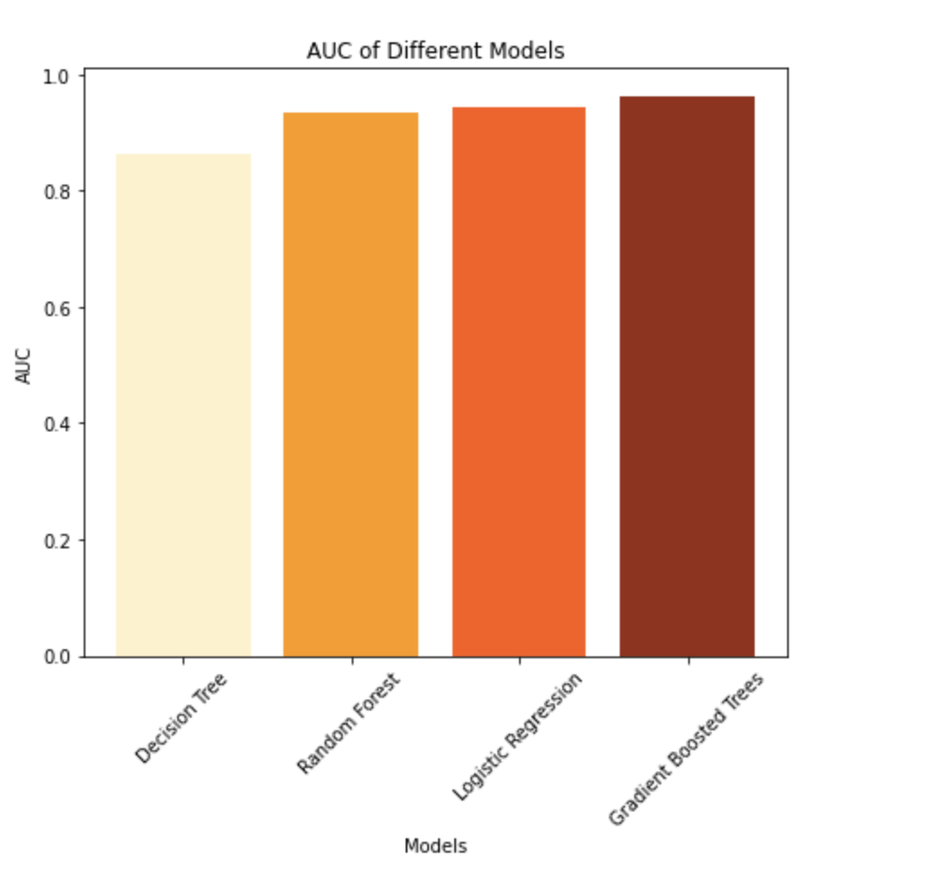
Model Selection
Target Variable: Rewards_Program
Logistic Regression
Decision Tree
Random Forest
Gradient Boosting
Logistic Regression AUC: 0.943
Decision Tree AUC: 0.864
Random Forest AUC: 0.934
Gradient Boosted Trees AUC: 0.963

Slide 26
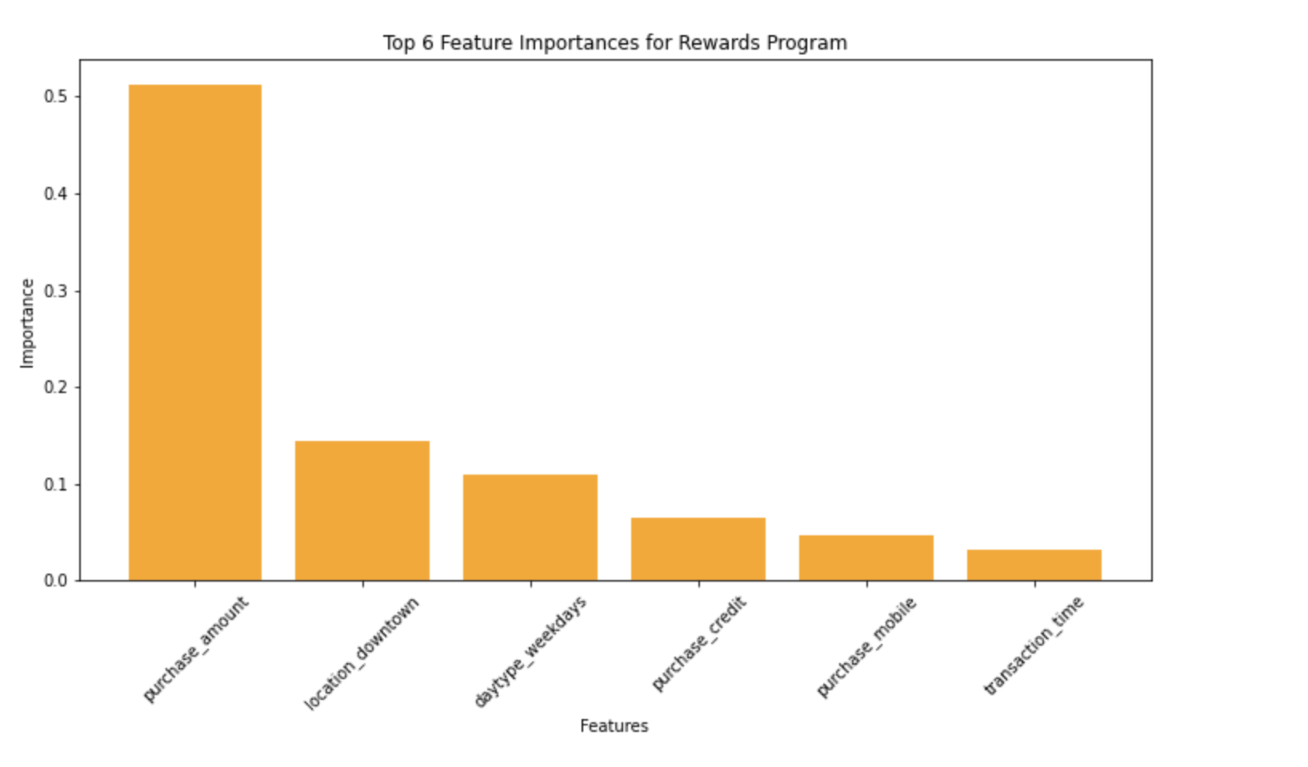
Feature Importance
purchase_amount | 0.5128
location_downtown | 0.1444
daytype_weekdays | 0.1094
purchase_credit | 0.0640
purchase_mobile | 0.0467
transaction_time | 0.0316

Slide 27
Feature Importance
 | Purchase Amount | Wait Time | Rewards Program
Age
Rewards
Purchase Method
WeekDay
Transaction Time
Location
Income

Slide 28


06
Key Findings &
Insights
04

Slide 29
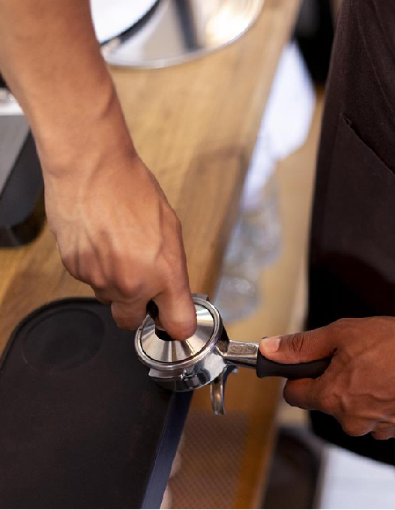
Age vs Purchase Amount
Rewards vs Purchase Amount
Higher age is associated with lower purchase amounts
Customers who join the rewards program tend to have higher purchase amounts

Slide 30
Strategy
Marketing campaigns for younger customers
Offer discounts or promotions on popular menu items or new products
Offer loyalty rewards to older customers
Offer the discount based on the frequency of visits
Marketing campaigns for non-rewards members
Highlighting the benefits of membership to encourage them join the program

Slide 31

Payment methods vs Waiting time
Using credit cards and mobile payments is associated with decreased waiting time for customers
Day of week vs
Waiting time
Customers are more likely to experience longer wait times on weekdays
Time of day vs
Waiting time
Waiting time tends to decrease as transaction time progresses

Slide 32
Strategy
Encourage cashless payments
Offer discount to customers who use credit card and mobile payment
Manage peak hours on weekdays
Increase staff during the peak hours
Offer promotions or discount during non-peak hours
Optimize operations throughout the day
Streamline operations and reduce waiting time during busier period
Offering special promotion in the evening

Slide 33

Downtown customers are more likely to be rewards program members
Purchase amount is related to rewards program, customers with higher purchase amounts more likely to be rewards member
Rewards members is more likely to spend on weekdays
Key Findings of Rewards Program

Slide 34
Strategy
Develop targeted marketing campaigns towards at downtown customers join in the rewards program
Offer additional rewards or incentives for customers who make high purchase amounts or use rewards program frequently
Free items for reaching certain spending thresholds

Slide 35
THANK YOU !

